Slide 1
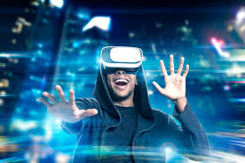
VIRTUAL REALITY
Murugeswari C

Slide 2
Agenda
What is VR?
History of VR.
Types of VR.
Virtual Reality Hardware.
Applications of VR
References

Slide 3
WHAT IS VR?
Virtual Reality is a computer generated world with which the user can interact
Virtual Reality is the illusion of a Real , Three-dimensional, Interactive computer generated Reality, where Sight , Sound and sometimes even Touch are simulated to create Pictures, Sounds and Objects, that actually seem real.

Slide 4
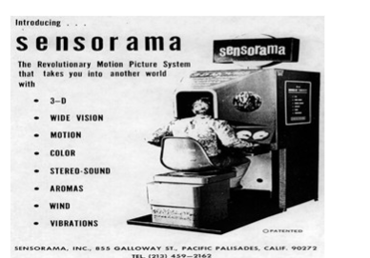
HISTORY OF VR
1950’s visionary cinematographer
Morton H Eilig built a single user console called
Sensorama.
This enabled the user
watch television in
three dimensional ways.

Slide 5
TYPES OF VR
Desktop(Window on a World) Virtual Reality.
Immersive Virtual Reality.
Augmented Virtual Reality.
Video Mapping Virtual Reality.
Telepresence
Mixed Reality

Slide 6
Desktop VR(Window on World)
Desktop VR involves displaying a 3-dimensional world on a regular desktop without use of any specialized movement-tracking equipment.
A user can then interact with that environment, but is not immersed in it. .
The next step beyond the Window on World view is the immersion using a virtual headset-Immersive VR.
LifeForms lets choreographers create sophisticated human motion animations. Choreographers can create, fine-tune, and plan dances "virtually" on the computer.

Slide 7
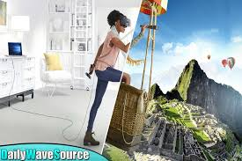
IMMERSIVE VR
Immersive VR is a perception of being physically present in a non-physical world.
The user has no physical contact with the physical world.
Often equipped with a
Head Mounted Display
(HDM)

Slide 8
Immersive VR Continued…
Immersive VR uses a HMD to project video directly in front of the user’s eyes, plays audio directly into the user’s ears, and can track the whereabouts of the user’s head.
Then a dataglove (or datasuit) is used to track movements of the user’s body and then duplicate them in the virtual environment.
When the user cannot distinguish between what is real and what is not, then immersive VR has succeeded

Slide 9
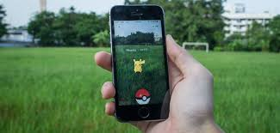
AUGMENTED VR
AR integrates the computer generated virtual objects into the real world.
This involves literally augmenting reality with virtual information.

Slide 10
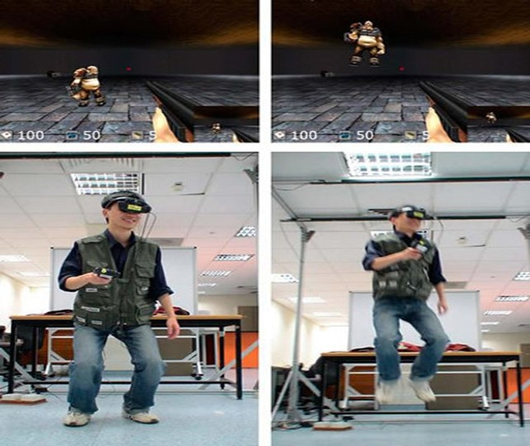
VIDEO MAPPING VR
Video Mapping VR uses cameras to project an image of the user into the computer program, thus creating a 2D computer character.

Slide 11
Telepresence
Telepresence is exactly what it sounds like: tele , “at a distance”, and presence, “being present”.
The sensors are therefore controlled and operated remotely by the user.
Consider bomb disposal robots, undersea exploration, and drones as being operated via telepresence VR.

Slide 12
TelePresence Examples
ThomasCook-Consumers can project themselves in hotels, destinations, consuming specific products and services, and experiencing a new reality.
They have started a campaign named “try before you buy”, in which VR is used for travelers to have a pre-trip experience and be more certain of their decisions, minimizing possible risks.
Patients in hospitals-To distract themselves from the environment
Education-
NASA has implemented an educational program in conjunction with the Telepresence-controlled Remotely Operated underwater Vehicle (TROV) that has been deployed to Antarctica (Stoker, 1994).
By means of a distributed computer control architecture developed at NASA, school children in classrooms across the U.S. can take turns driving the TROV in Antarctica.

Slide 13
Mixed Reality
The predominantly virtual spaces where real world objects or people are dynamically integrated into virtual worlds to produce new environments and visualizations where physical and digital objects co-exist and interact in real time.
This could be a fighter pilot’s view of maps or key data points displayed inside his helmet, or a surgeon being able to view real-time patient information during a complex surgery while wearing an HMD.

Slide 14

Web VR
WebVR is an open specification that makes it possible to experience VR in your browser. The goal is to make it easier for everyone to get into VR experiences, no matter what device you have.

Slide 15
Virtual Reality Hardwares

Slide 16
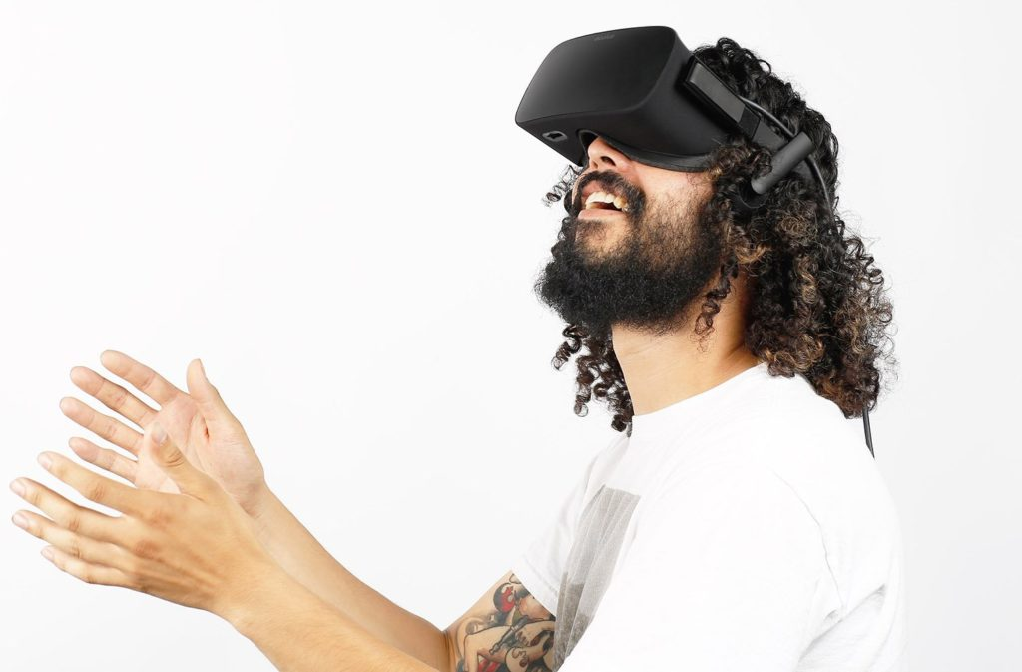
OCULUS RIFT
Specifically designed for video gaming, it has a high field of view, delivering the very best in immersive virtual experiences.

Slide 17
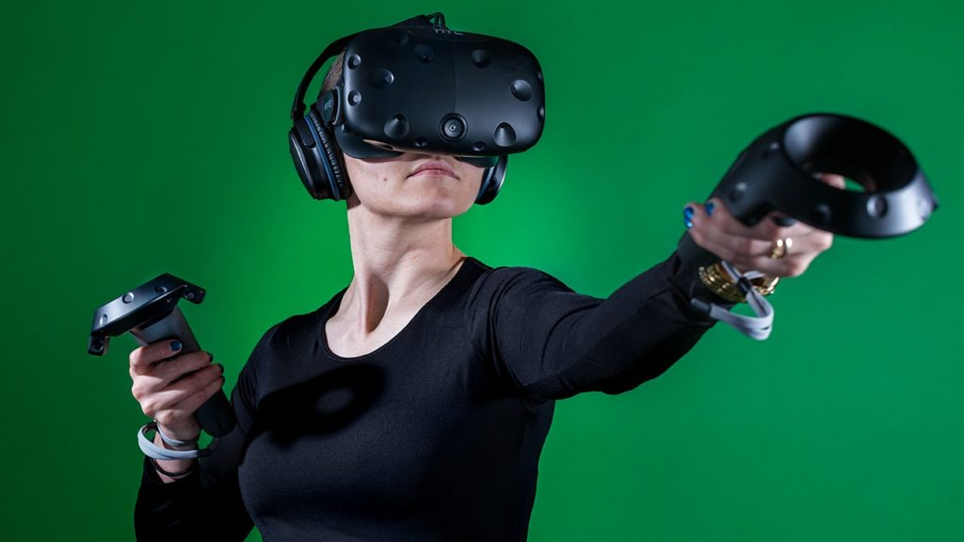
HTC Vive
HTC’s VR system – brought to us in partnership with Valve, and powered by Steam VR – is the leading VR headset and controller combo on the market today.

Slide 18
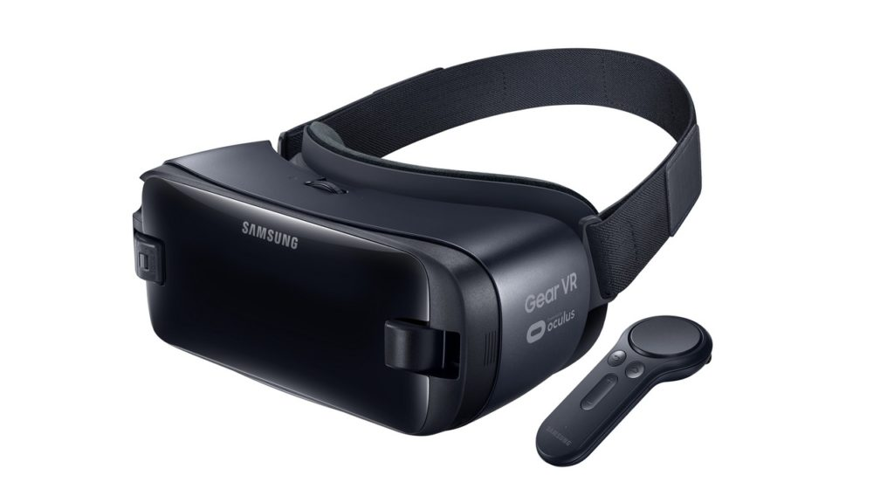
Samsung Gear VR
It does require a smartphone device to power it, and naturally works best with Samsung brand phones such as the Galaxy S6, S6 Edge, S7, and S7 Edge.

Slide 19
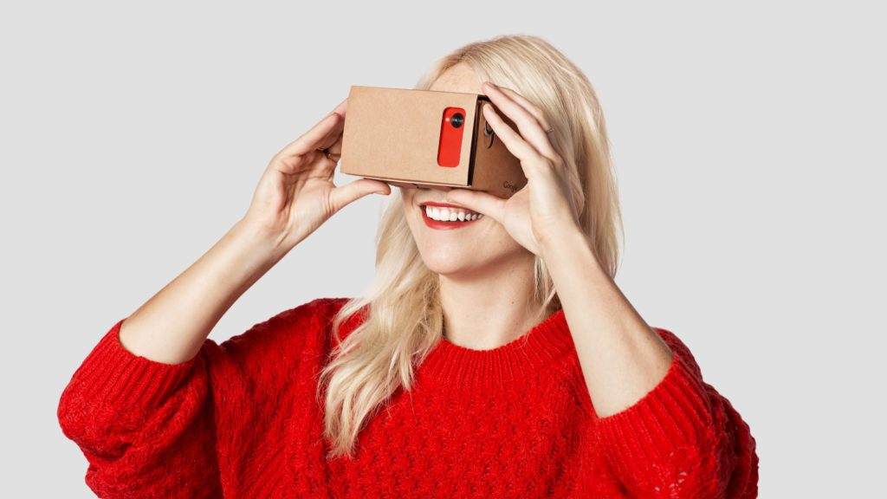
Google Cardboard
Another VR headset option for use with your phone, this one is, as previously mentioned, a great deal cheaper than most other HMDs
The perfect option for those who wish to only dip their toe into the world of Virtual Reality.

Slide 20
APPLICATIONS
Military Training
Education
Entertainment
Medical field
Construction
Gaming

Slide 21
References
https://en.wikipedia.org/wiki/Immersion_(virtual_reality)
https://appreal-vr.com/blog/virtual-reality-and-its-kinds/
https://www.youtube.com/watch?v=NND7Hk5fYdI

Slide 22
Queries?

Slide 23
Thank You!

